Slide 1
Logistic Regression Flashcard

Slide 2
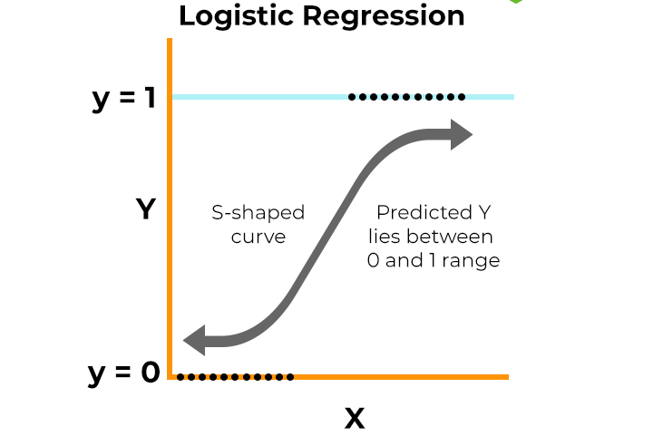
Question
What is logistic regression? Explain the training process

Slide 3

What is logistic regression?
Mathematically, the line can be expressed as
Logistic regression is a widely-used statistical method for binary classification tasks, meaning we typically use it to predict the likelihood of an outcome belonging to one of two classes
For example, in business contexts, it might help us assess whether a customer is likely to churn or if a transaction is fraudulent.
It’s a type of generalized linear model that uses a logistic, or sigmoid, function to map input values into a probability between 0 and 1, which makes it highly suitable for classification
x_i​ are the feature values of a data point,
β_i​ are the model coefficients (weights),
β_0​ is the intercept term, which shifts the decision boundary

Slide 4



What is logistic regression?
Optimization: The goal is to minimize the total cost over all training examples by adjusting the coefficients
Sigmoid function: To ensure that the output is a probability between 0 and 1, the linear combination z is passed through the sigmoid function, which maps any real number to the range [0,1]
Cost function: Logistic regression uses a cost function called log loss or binary cross-entropy to quantify the difference between predicted and actual outcomes. The cost for a single data point is:

Slide 5
Logistic regression Training
Using optimization algorithms like gradient descent, we adjust the coefficients iteratively to maximize the likelihood.
The goal is to minimize the difference between the predicted probability and the actual outcome.
Training logistic regression involves finding the best set of coefficients (weights) for each input feature that maximizes the likelihood of correctly classifying the outcomes.
This is done through a process called maximum likelihood estimation (MLE]
Each data point is passed through a logistic function, which maps the linear combination of weights and features to a probability value
We then calculate the likelihood of the predicted probability given the true class labels

Slide 6
Question
Can you explain the logistic function (sigmoid function) used in logistic regression?

Slide 7
Logistic regression-Sigmoid
The sigmoid curve is an S-shaped, continuous curve that maps any real number into the range [0, 1].
When z=0, the output of the sigmoid function is 0.5, meaning the model is uncertain between the two classes.
As z becomes large and positive, the sigmoid output approaches 1, indicating high confidence in one class.
As z becomes large and negative, the output approaches 0, indicating high confidence in the opposite class.
The logistic function, often called the sigmoid function, is central to logistic regression.
It's what allows us to transform a linear equation, which could produce any real number as output, into a probability between 0 and 1, which is ideal for classification tasks

Slide 8
Question
What are the key assumptions underlying logistic regression?

Slide 9
Logistic regression - Assumptions
Dependent variable has binary outcome
There exists a linear relationship between the independent variable and the log-odds of dependent variable
Residuals are independent of each other
No perfect multi collinearity

Slide 10
Question
How do you interpret the coefficients in a logistic regression model?

Slide 11

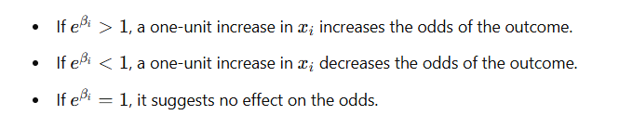
Logistic regression - Coefficients
Each coefficient βi​ indicates the change in the log-odds of the outcome for a one-unit increase in that predictor, holding all other predictors constant
Let’s say we’re predicting whether a customer will churn based on features like account tenure and monthly spending. Suppose the coefficient for monthly spending (x1​) is 0.04.
This means odds of churning increase by 4% for each dollar increase in spending, holding all other variables constant

Slide 12
Question
What is an odds ratio, and how is it calculated in the context of logistic regression?

Slide 13
Logistic regression - Coefficients
The odds ratio is a key metric that allows us to interpret the impact of each predictor on the probability of an outcome
The odds ratio specifically tells us how the odds change with a one-unit increase in a predictor variable. In other words, it helps us quantify the effect of each predictor on the likelihood of the event happening
Let’s say we’re predicting whether a customer will churn based on features like account tenure and monthly spending. Suppose the coefficient for monthly spending (x1​) is 0.04.
This means odds of churning increase by 4% for each dollar increase in spending, holding all other variables constant

Slide 14
Question
What are the different methods of fitting a logistic regression model?

Slide 15
Logistic regression - Assumptions
Scikit-learn :
liblinear
Newton-cg
Lbfgs
sag
Maximum Likelihood Estimation
Gradient Descent
Newton-Raphson method: This is a second-order optimization method that uses the Hessian matrix (the second derivative of the cost function) to update parameters
Quasi Newton Method: BFGS: Similar to the Newton-Raphson method but approximate the Hessian rather than calculating it directly. The BFGS (Broyden–Fletcher–Goldfarb–Shanno) algorithm is one such method

Slide 16
Question
What is the Hosmer-Lemeshow test, and how does it help in logistic regression?

Slide 17
Hosmer-Lemeshow test
Key Components :
Grouping: The test divides the data into a specified number of groups (usually 10) based on predicted probabilities. This is done to compare observed and expected frequencies of outcomes
For each group calculate the frequency
Chi-Squared Statistic: The test then computes a chi-squared statistic based on the differences between observed and expected counts across the groups
P-Value: The resulting statistic is then compared to a chi-squared distribution with g−2 degrees of freedom (where g is the number of groups) to obtain a p-value
The Hosmer-Lemeshow test is a statistical test used to assess the goodness of fit for logistic regression models.
It evaluates whether the observed event rates match the expected event rates in subgroups of the dataset.
Essentially, it tests how well the logistic regression model fits the data, particularly in terms of its predictive accuracy

Slide 18
Hosmer-Lemeshow test
Null Hypothesis: The null hypothesis states that there is no difference between observed and expected frequencies, implying a good fit of the model to the data
A high p-value (typically greater than 0.05) indicates that the model fits the data well, and we fail to reject the null hypothesis
A low p-value (typically less than 0.05) suggests a significant difference between observed and expected frequencies, indicating poor model fit

Slide 19
Question
What is pseudo R-squared, and how is it interpreted in logistic regression?

Slide 20



Pseudo R squared
Types:
Cox and Snell R-squared
Nagelkerke R-squared
McFadden’s R-squared
Pseudo R-squared is a set of statistics used to evaluate the goodness of fit for logistic regression models, as traditional R-squared from linear regression does not directly apply due to the different nature of the dependent variable
Pseudo R-squared provides an indication of how well the independent variables explain the variability in the dependent variable, offering insight into the model's predictive power
L_0 is the likelihood of the null model
L_M is the likelihood of the fitted model

Slide 21
Question
What is a null deviance, and how does it differ from residual deviance in logistic regression?

Slide 22
Null-Deviance
Deviance is a measure of how well a model fits the data, and it is calculated based on the likelihood of the model.
Null deviance measures the goodness of fit of a model that includes only the intercept
A higher null deviance indicates a poorer fit of the null model, while a lower null deviance suggests that the intercept model provides a good baseline fit
Residual deviance measures the goodness of fit of the logistic regression model that includes the predictors.
It assesses how well the model with predictors explains the variation in the response variable compared to the saturated model
A lower residual deviance indicates that the model with predictors fits the data better than the null model. If the residual deviance is significantly lower than the null deviance, it suggests that the predictors contribute meaningfully to the model.

Slide 23
Question
What is the Wald test in logistic regression, and when is it used?

Slide 24
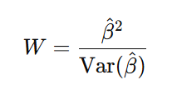
Wald Test
The Wald test is a statistical test used in logistic regression to assess the significance of individual coefficients in the model.
It helps determine whether a specific predictor variable significantly contributes to the prediction of the dependent variable
The Wald test evaluates the null hypothesis that a specific coefficient (β) associated with a predictor variable is equal to zero
The test statistic follows a standard normal distribution under the null hypothesis.
A large Wald statistic (and corresponding small p-value) indicates that the predictor variable is statistically significant in predicting the outcome variable, suggesting that changes in the predictor are associated with changes in the odds of the outcome.

Slide 25
Question
What is the impact of outliers on logistic regression, and how can they be managed?

Slide 26
Outliers in Logistic Regression
Manage outliers:
Data Transformation
Huber regression
Removing outliers
Regularization
Sensitivity Analysis
In logistic regression, outliers can distort the estimates of the coefficients, leading to unreliable predictions
Since logistic regression uses the maximum likelihood estimation (MLE) method to find the best-fitting model, extreme values in the dataset can skew the likelihood surface, ultimately affecting the model’s accuracy and interpretability
Identifying outliers in logistic regression typically involves examining the residuals or using diagnostic measures such as Cook's distance, which indicates how much the fitted values change when a particular observation is removed

Slide 27
Question
What preprocessing steps would you take before fitting a logistic regression model?

Slide 28
Preprocessing steps
Data cleaning
Handle Missing values
Removing duplicates
Encoding categorical variables
Feature Scaling
Handling class imbalance
Outlier detection and treatment
Train-Valid-Test split

